Slide 1

Executive Presentation: Big Mountain Resort Pricing Analysis
By Manuel Ramirez

Slide 2
Problem Identification
Big Mountain Resort's current ticket price is $81.
Competitor analysis suggests the resort may be underpricing its tickets.
The resort must balance pricing adjustments with operational costs, including a new chair lift.
Objective: Develop a data-driven pricing strategy to optimize revenue while remaining competitive.

Slide 3
Recommendation and Key Findings
Recommended Ticket Price: $92.65, based on predictive modeling.
Key Findings:
The resort ranks highly in features such as vertical drop, snow-making area, total chairs, and skiable terrain.
Facility-based pricing models indicate potential for higher revenue without significant demand loss.
A price adjustment could help cover operational costs while maintaining competitive positioning.

Slide 4
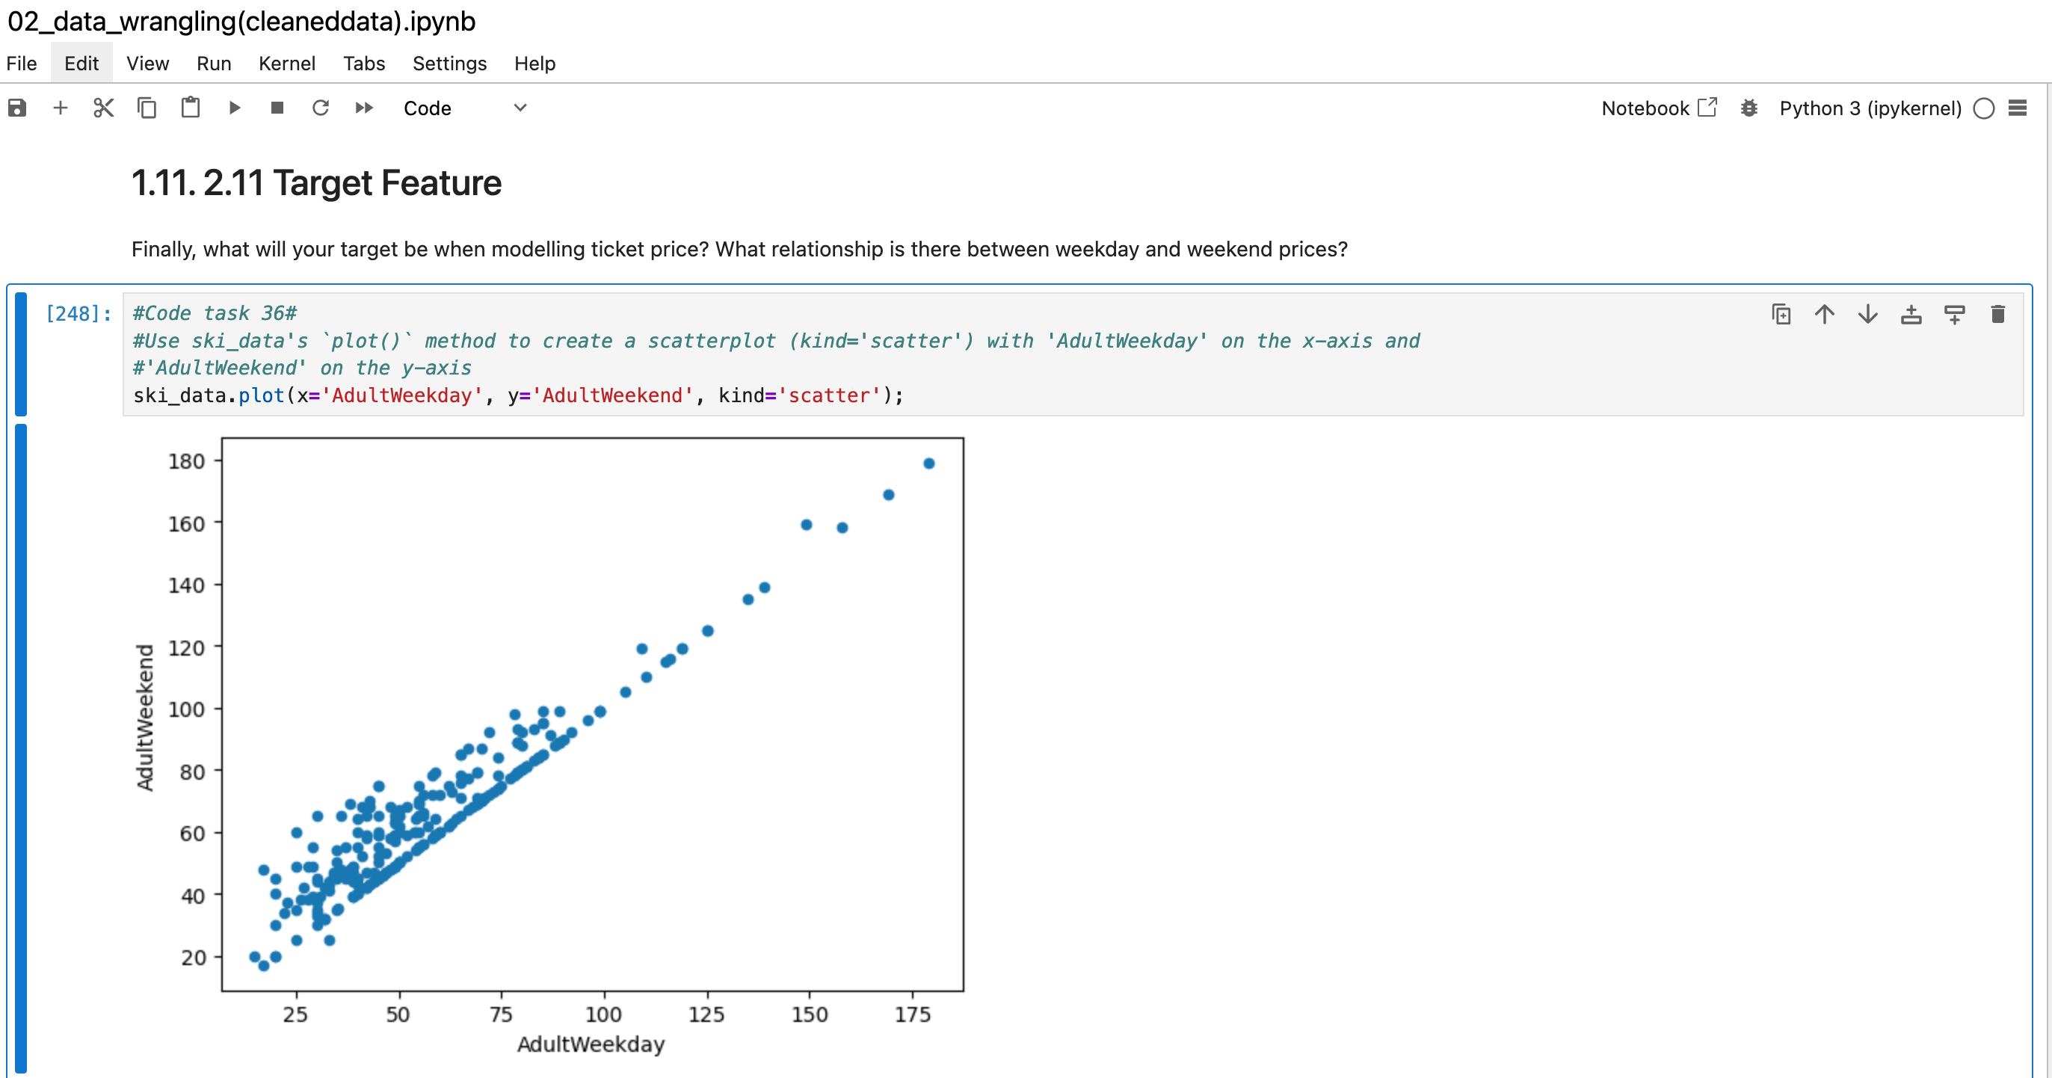

Slide 5
Modeling Results and Analysis
Data Wrangling & Cleaning
Initial dataset: 330 rows, 27 columns.
Processed dataset: 277 rows, 25 columns.
Key Actions:
Removed irrelevant and highly correlated columns.
Addressed missing data through imputation and deletion.
Defined ticket price as the target feature.

Slide 6
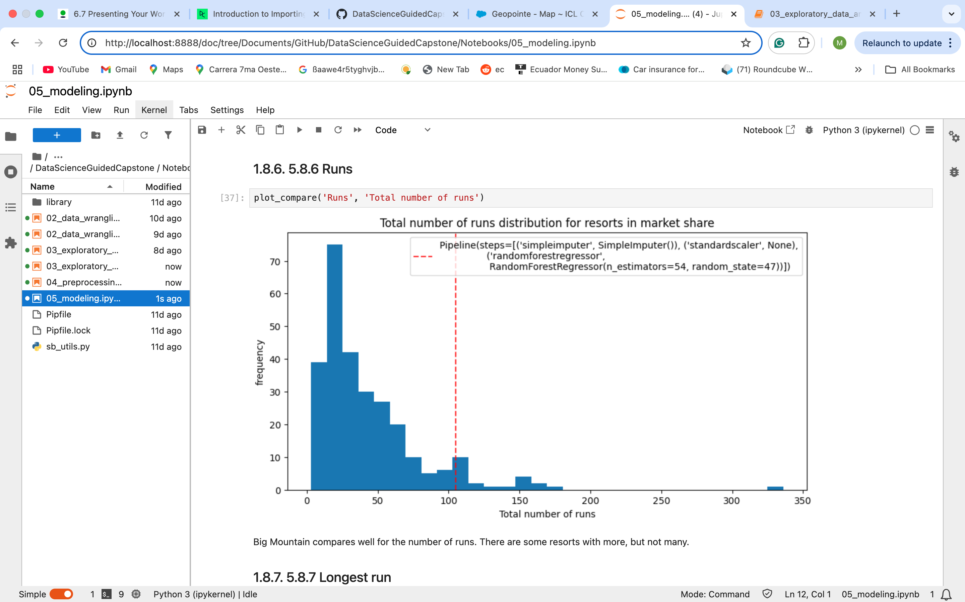

Slide 7
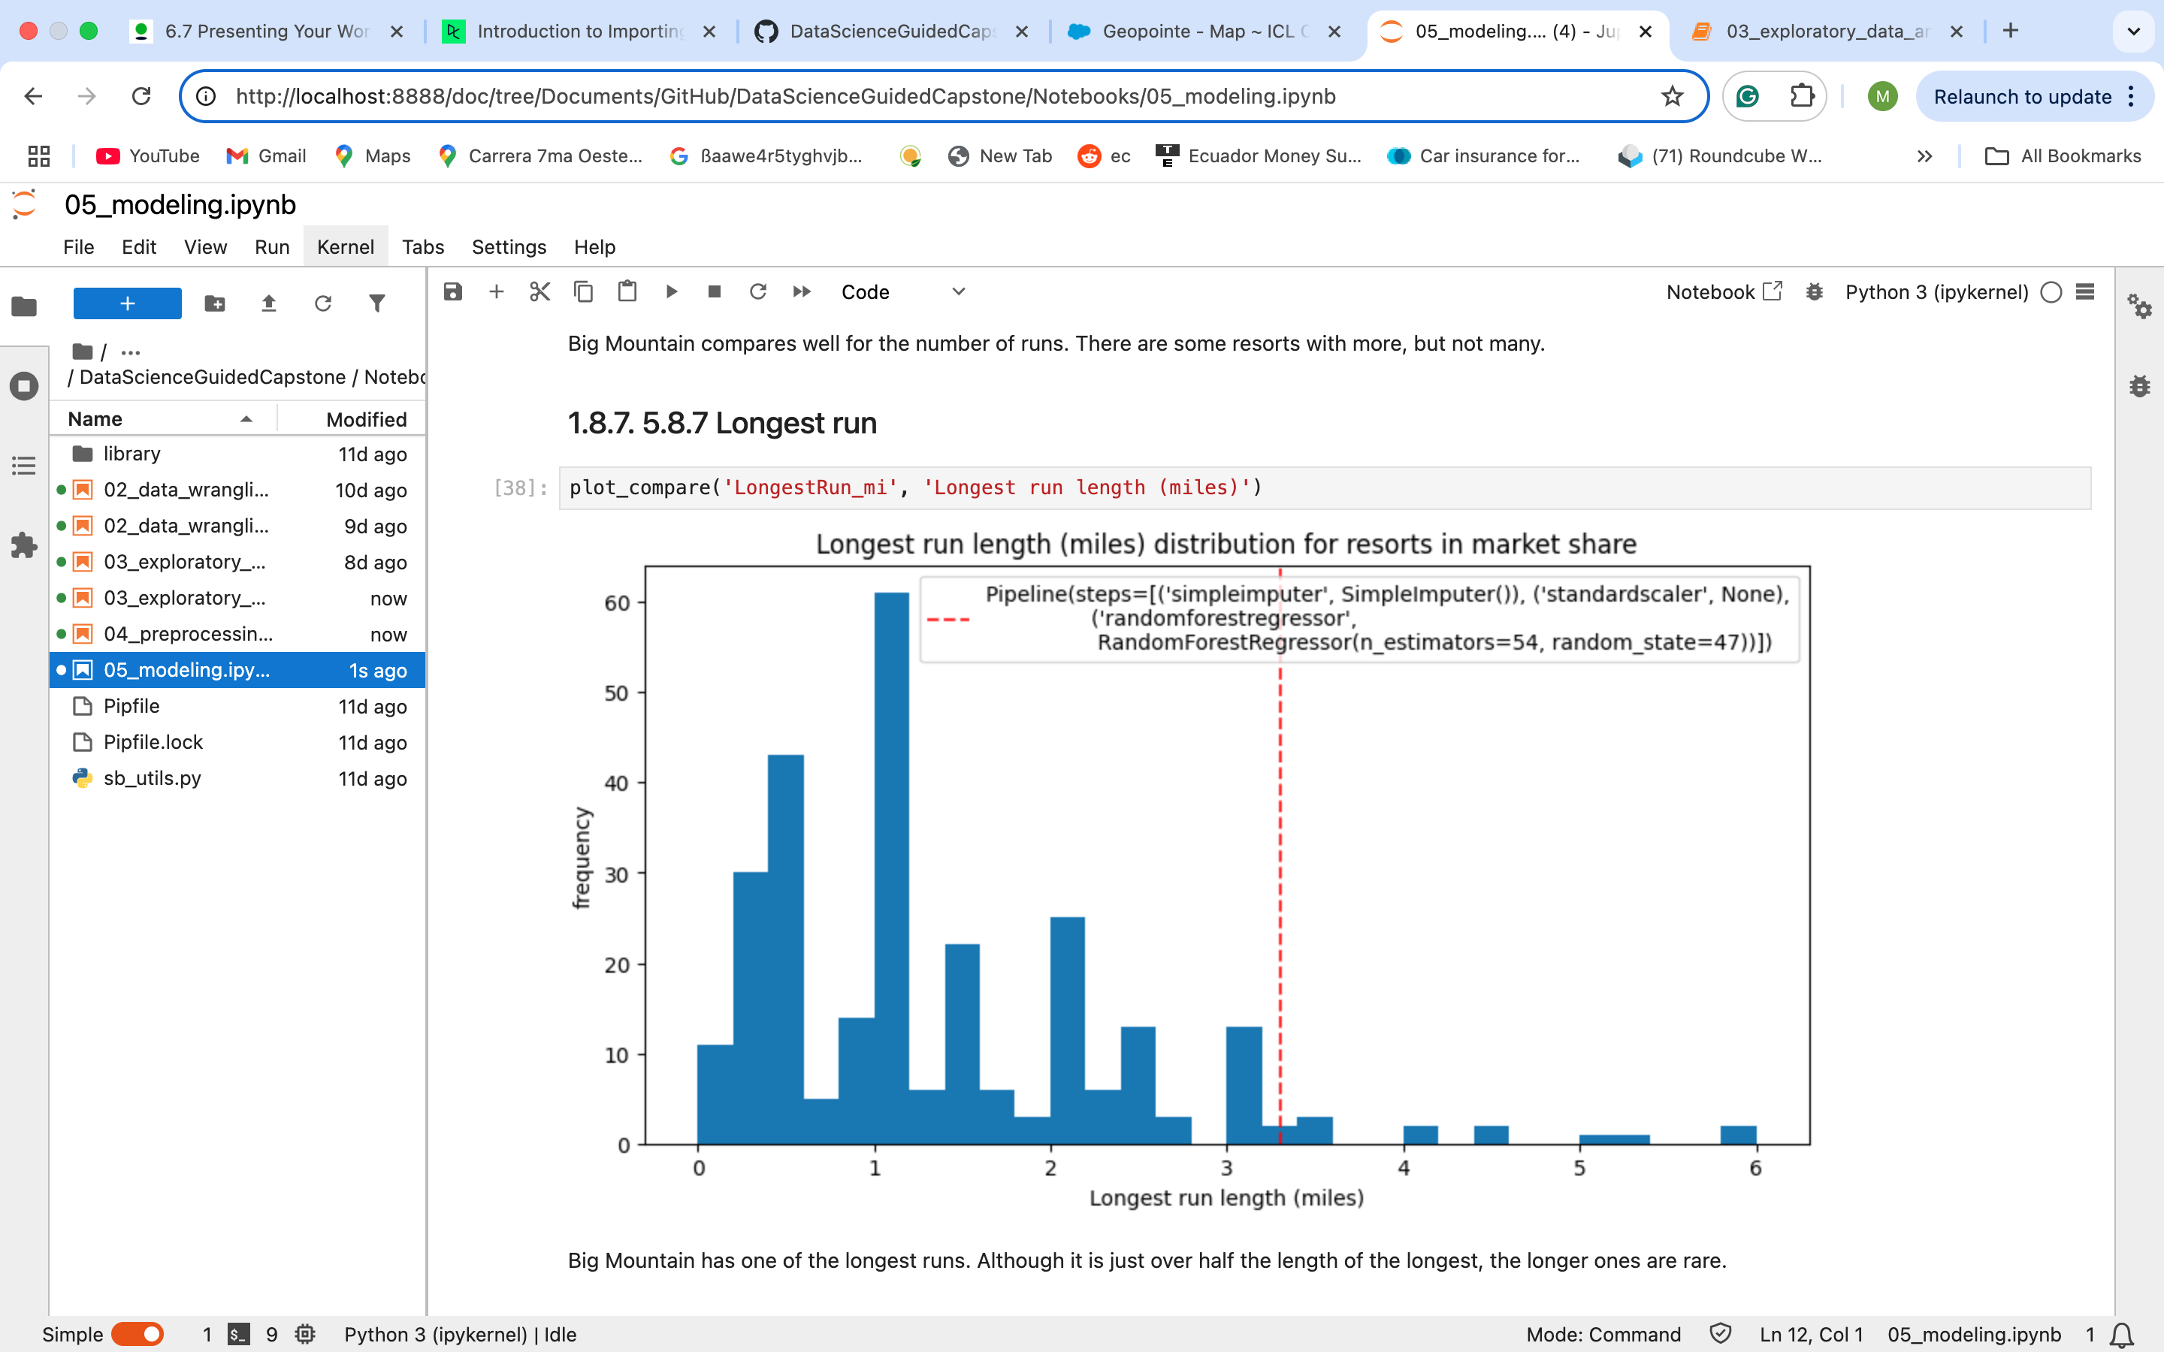

Slide 8
Exploratory Data Analysis (EDA)
Key Insights:
Certain states show consistent price variations.
Feature importance analysis revealed vertical drop as a major pricing determinant.
Categorical features like state require careful encoding to prevent multicollinearity.

Slide 9
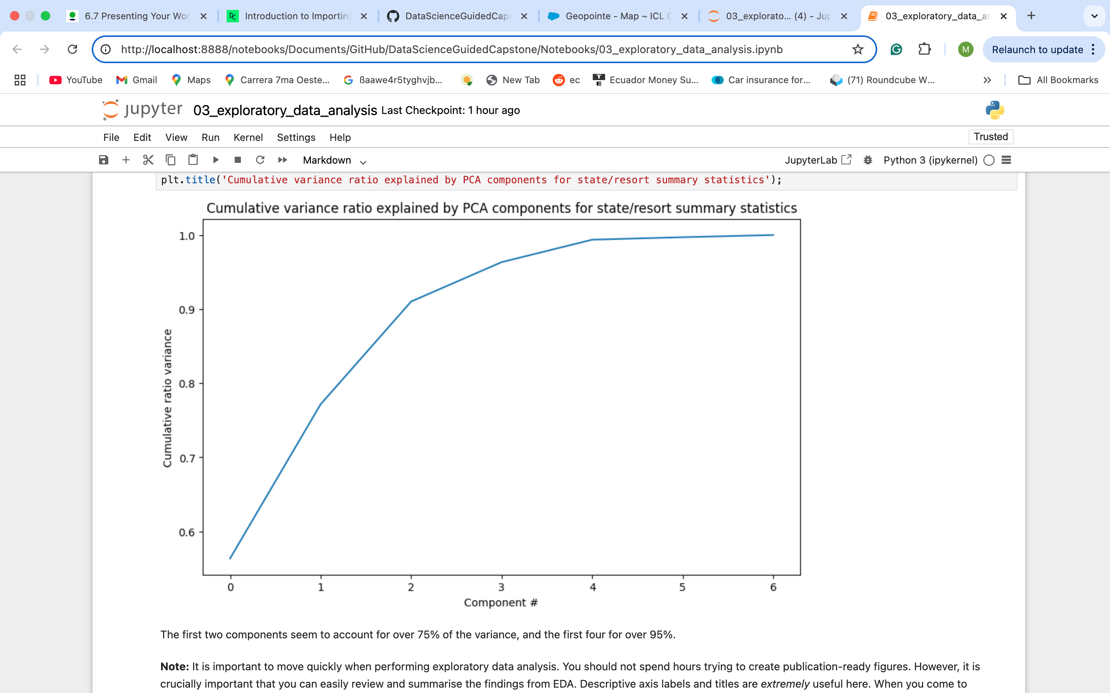

Slide 10
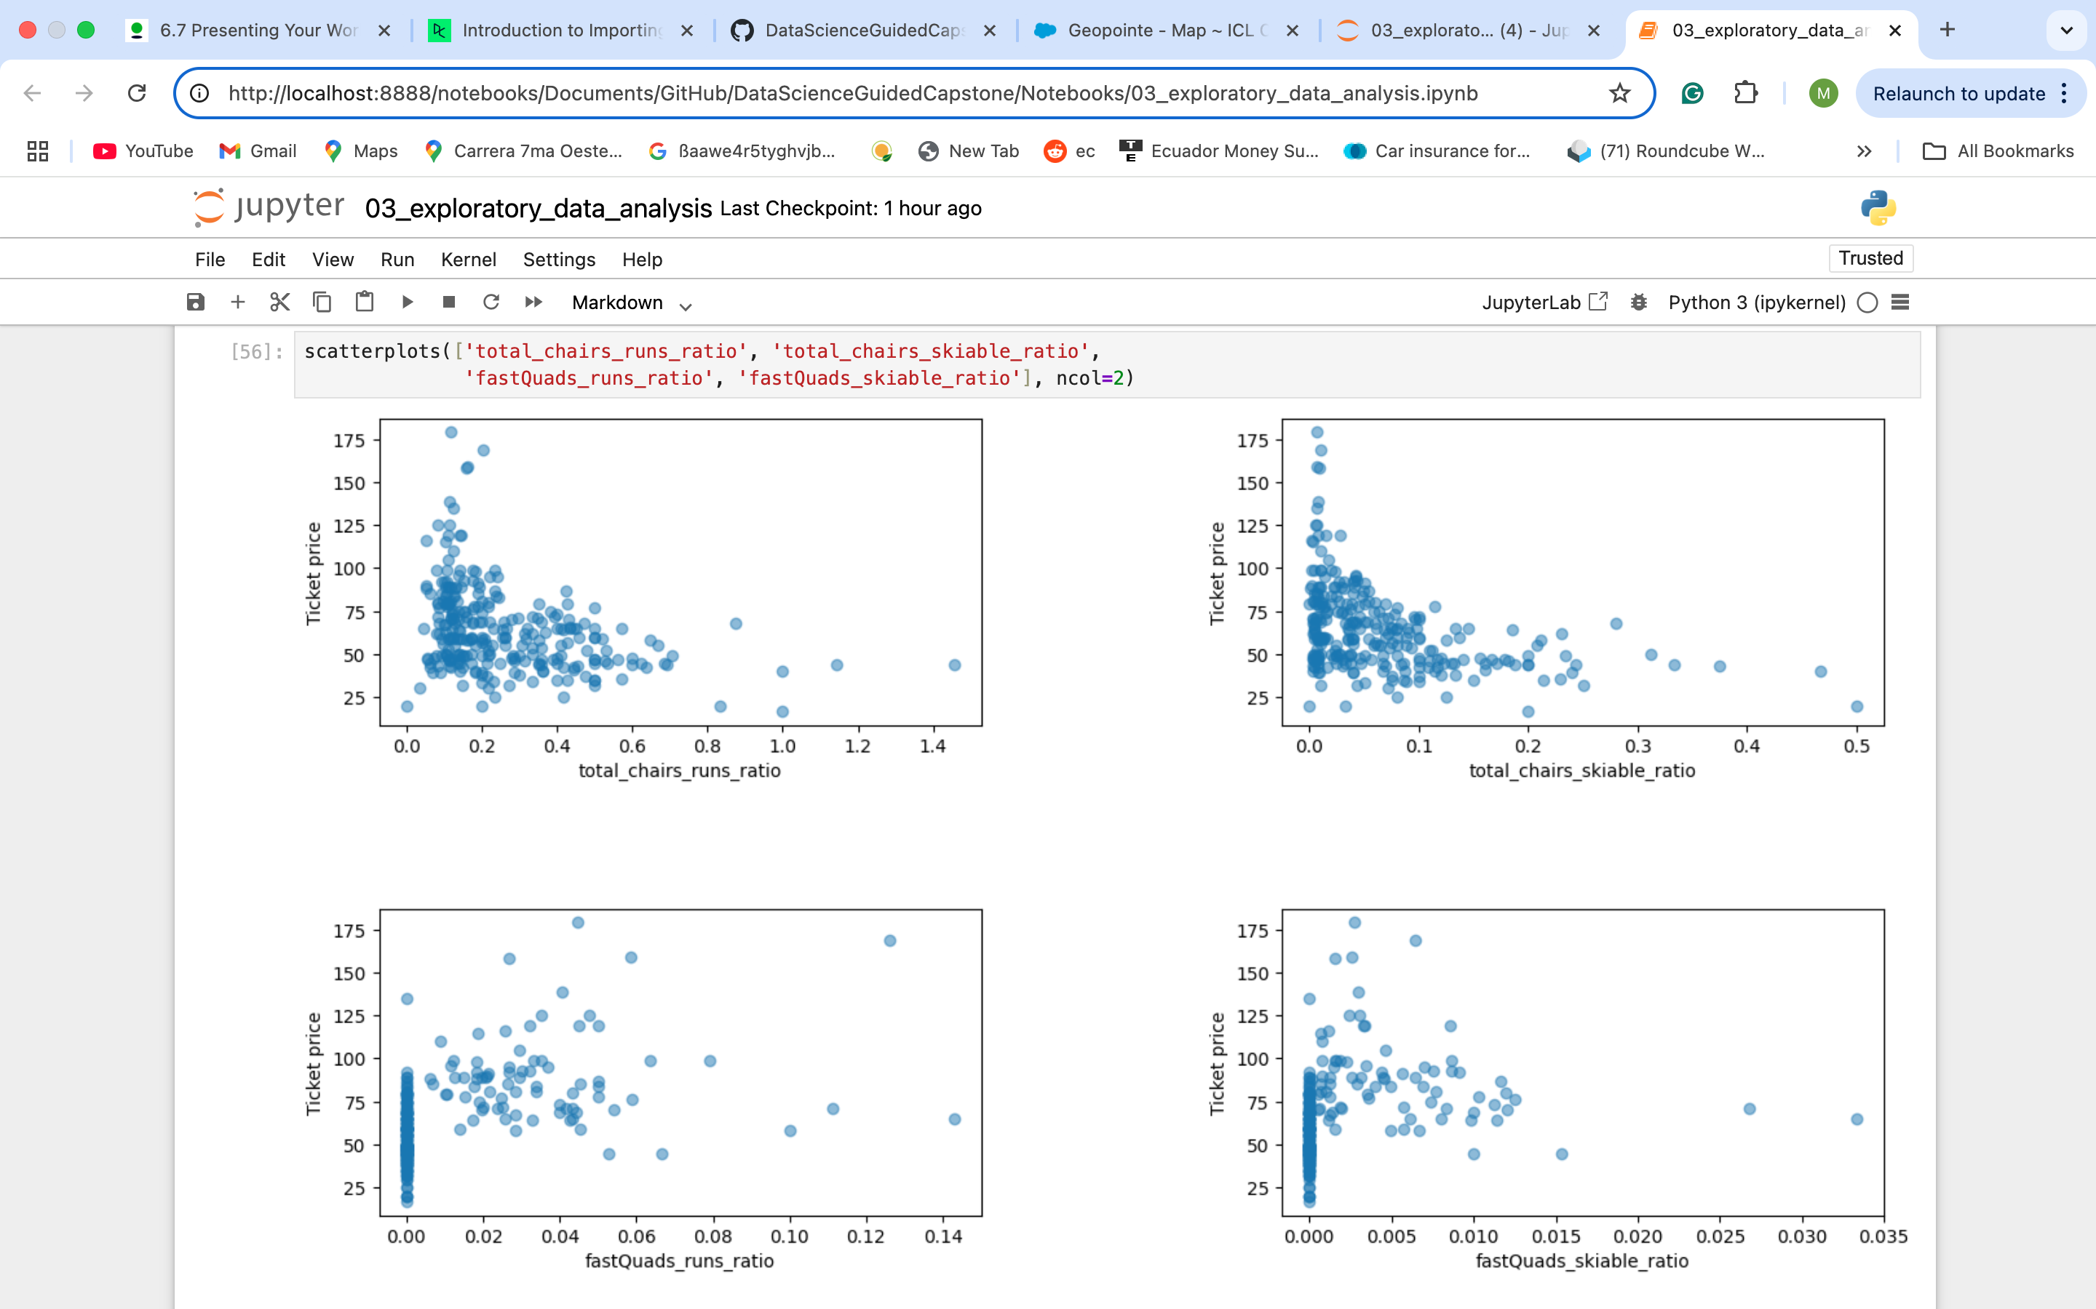

Slide 11
Model Development
Baseline Model:
Used the average ticket price as a predictor for comparison.
Found limited predictive accuracy.
Linear Regression Model:
Initially overfit; optimized using feature selection (SelectKBest, k=27).
Cross-validation confirmed stable performance.

Slide 12
Random Forest Regressor:
Improved accuracy through hyperparameter tuning.
Outperformed linear regression in capturing nonlinear relationships.
Final Model Choice: Random Forest Regressor, due to superior predictive performance.

Slide 13
Operational Cost Considerations
New Chair Lift:
Additional operating cost per visitor: estimated at $X per ticket (based on a five-day pass purchase assumption).
Increasing ticket price to $92.65 would help offset these costs.
Further financial analysis needed to determine breakeven scenarios.

Slide 14

Future Considerations & Business Integration
Data Limitations:
Lacks operating cost breakdowns (fixed/variable expenses, marketing impact).
Does not account for demand sensitivity and external economic conditions.

Slide 15
Business Strategy Recommendations:
Conduct stakeholder interviews to validate pricing strategy.
Implement a self-service analytics tool for real-time scenario testing.
Explore bundling options and dynamic pricing strategies.

Slide 16
Conclusion
Big Mountain Resort has an opportunity to optimize its pricing strategy.
A data-driven price increase to $92.65 is supported by modeling.
Further testing and business input are recommended before implementation.
Long-term strategy should include operational cost tracking and pricing automation tools.

